Slide 1
EMLex Unit B1.5 An introduction to corpus linguistics
Stefan Evert | FAU Erlangen-Nürnberg
www.linguistik.fau.de | www.stefan-evert.de

Slide 2
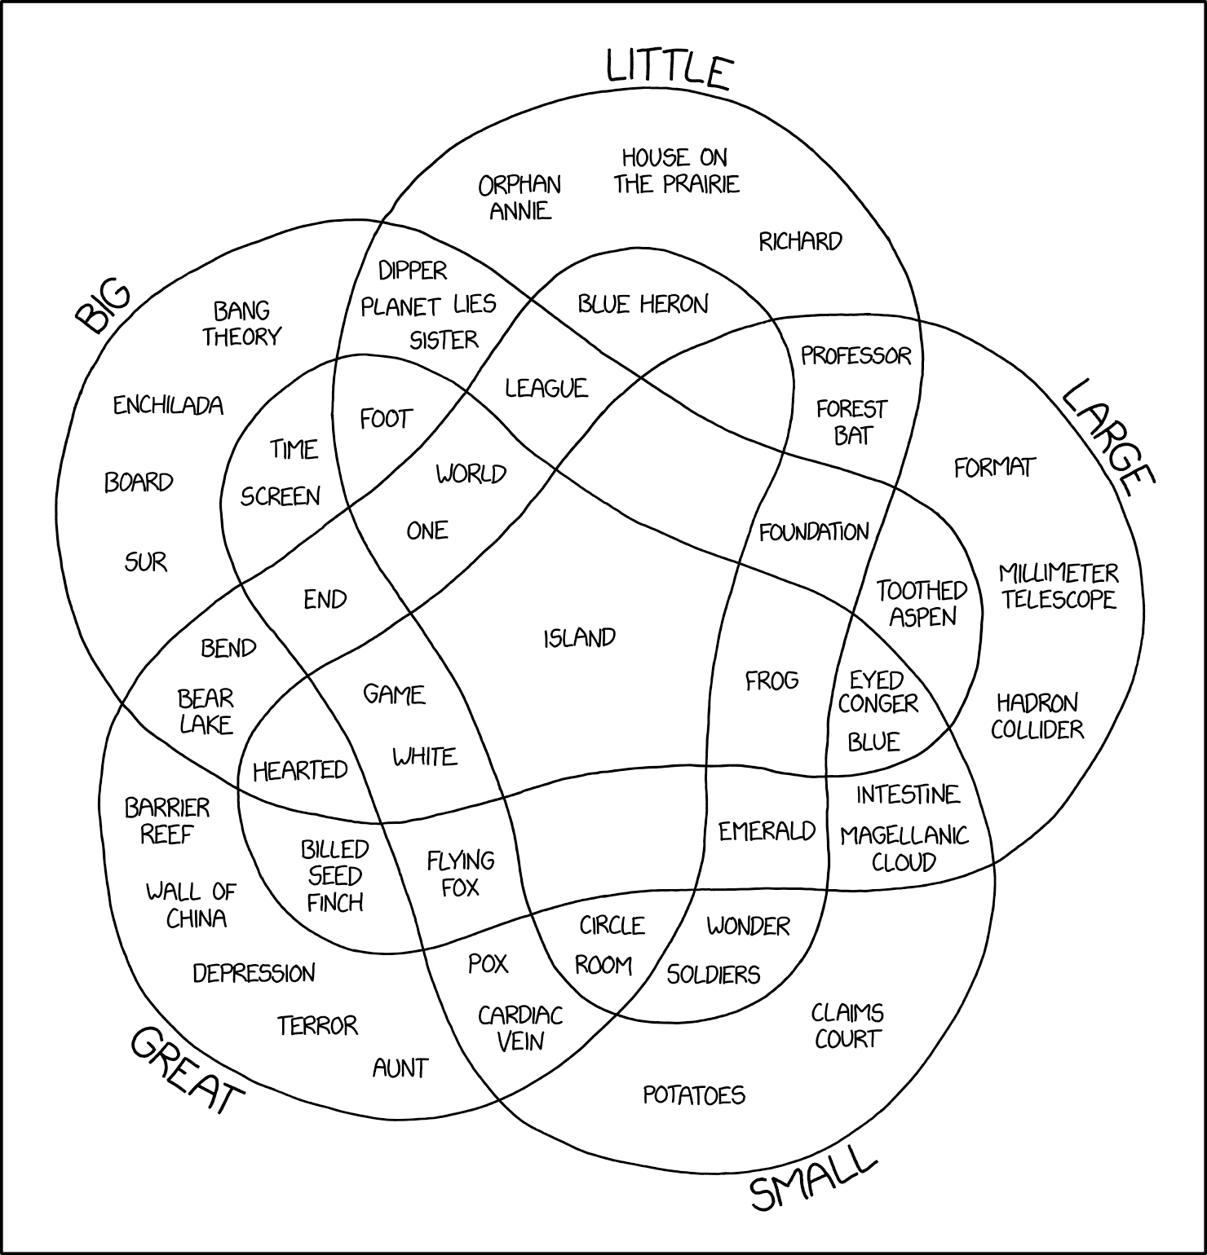
What is corpus linguistics?
In a nutshell …
The empirical scientific study of language based on authentic samples of language use
https://xkcd.com/2122/

Slide 3
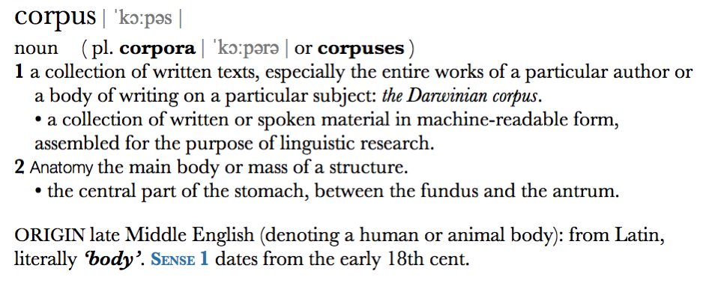
What is a corpus?
Corpus as electronic text collection (archive)
wide sense: often used in computational linguistics / NLP
Corpus as representative sample of language
narrow sense: dominant in corpus linguistics

Slide 4
Types of corpora
written vs. spoken vs. multimodal/multi-media
reference corpus vs. specialized corpus
synchronic vs. diachronic (discrete, continuous)
closed corpus vs. monitor corpus
monolingual vs. multilingual (parallel, comparable)
unannotated (raw text) vs. annotated
metadata = information about texts & speakers/authors
linguistic annotation = systematically coded interpretation
corpus size (in M = million running words)
small & clean vs. large & messy

Slide 5
History of corpus linguistics
First corpus-based quantitative studies in late 19th century
Orthography and frequency lists
Kaeding (1897): German frequency dictionary based on corpus of approx. 11 million words (completely manual analysis!)
Lexicography
Murray: several million index cards for OED (1879–1828)
Language acquisition
first longitudinal studies ca. 1876–1926 (parent diaries)
large cross-sectional studies ca. 1927–1957
Foreign language teaching
basic vocabulary, vocabulary levels, collocations (e.g. Palmer 1933)
Strucuralist language documentation
Boas (1940), Firth (1930–1955), …
Notes:
• Oxford English Dictionary (OED) was conceived and edited by Sir James Murray (1879–1915)
• Häufigkeitswörterbuch based on ca. 300 books analyzed by more than 665 workers, initiated by German stenographer Friedrich Wilhelm Kaeding (1843–1928)

Slide 6
History of corpus linguistics
Since 1950: Humanities Computing (➞ Digital Humanities)
Index Thomisticus by Robert Busa & IBM (1949–)
1950–1960: Mechanolinguistics (Juilland: contrastive corpora) ➞ quantitative / mathematical linguistics (Harris 1968)
1960–1980: Corpus linguistics as European counter-movement against mainstream of generative linguistics
Corpus-based grammars (e.g. Quirk/Greenbaum)
Survey of English Usage (SEU) since 1960
Brown Corpus 1961–1963
British contextualism (Firth & Sinclair)
Firth (1957) building on Malinowski & Jones, Sinclair (1991), COBUILD
principles of collocation & colligation, “trust the text”
Since 1990: CL established as subdiscipline of linguistics
Notes:
Index Thomisticus is a searchable electronic edition of the writings of Italian philosopher and theologian Saint Thomas Aquinas (1225–1274)

Slide 7
Applications of corpus linguistics
Dialectology & contrastive linguistics
Historical linguistics & language change
Language description (e.g. endangered languages)
Language teaching, language acquisition, CALL
Lexical semantics
Language variation, register studies (➞ Biber's MDA)
Lexicography & lexicology
Morphology (➞ quantitative productivity)
Phonology (esp. studies of phonological variation)
Pragmatics & discourse analysis (➞ rhetoric, ideology, politics, …)
Sociolinguistics (e.g. gender studies)
Stylometrics & literary studies
Syntax & grammar
Translation studies (➞ “translationese”, CAT)
Notes:
Quirk/Greenbaum/Leech/Svartvik: Comprehensive Grammar of English
Biber et al.: Longman Grammar of Spoken and Written English

Slide 8
Goals of corpus design
Representativeness
a corpus should be representative of the (sub-)language to be studied
full representativeness difficult to achieve
must at least be balanced (= good coverage of different registers, speakers, …)
Comparability
corpus studies often build on frequency comparison
prerequisite: comparable corpora

Slide 9
Why representativeness?
representative random sample
population
(of “objects”)
Statistics (hypothesis tests)
👿
👿
corpus data
(frequencies)
operationalized
hypothesis
about “language”
linguistic research question

Slide 10
Representativeness & sampling
Design criteria ➞ sampling frame
defines the population from which sample is taken
“A sampling frame is an operational definition of the population, an itemized listing of population members from which a representative corpus can be chosen.” (Biber 1993, 244)
Specification of sampling frame
mode (spoken/written), genre / text type, domain, …
publication date, region, medium, target audience, …
properties of speakers: sex, age, dialect, social class, …
Balance: include texts from all (combns of) categories

Slide 11
The stages of a corpus study
Operationalization
hypothesis, definition of population (sampling frame)
Corpus compilation
selection of texts (from sampling frame), digitization / format conversion
collection of metadata, legal & ethical issues
Representation format
standards: Unicode, XML, TEI, XCES, …
important for archiving and data exchange
Linguistic annotation
manual annotation, GUI, annotator agreement
automatic annotation with NLP tools for larger corpora

Slide 12
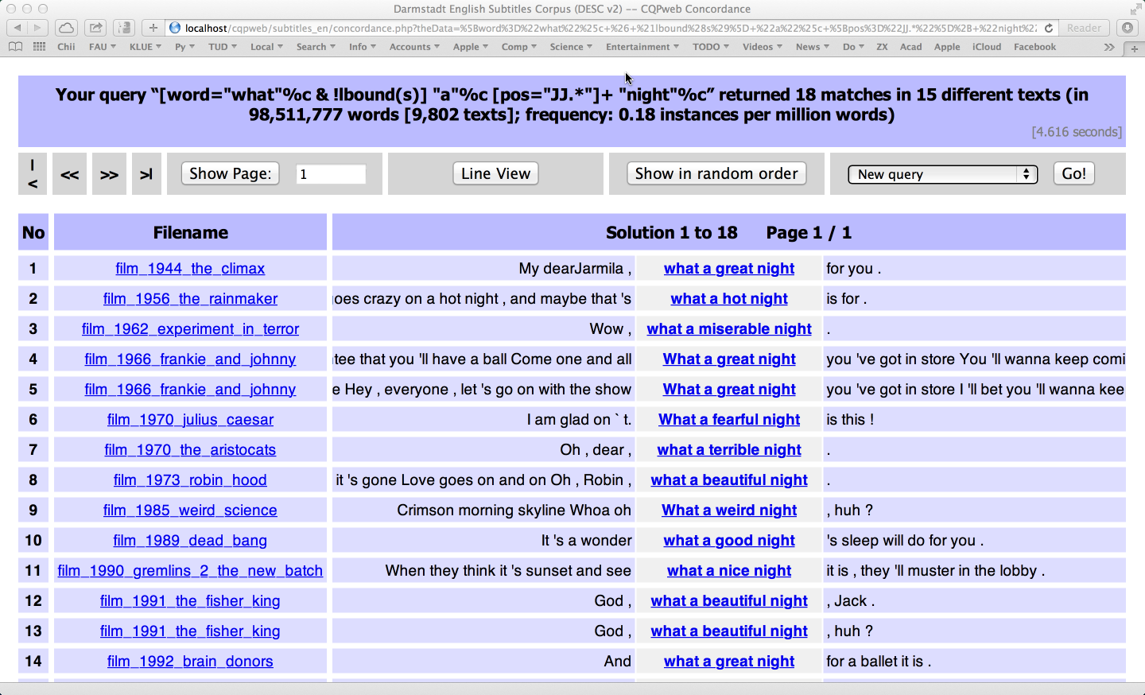
The stages of a corpus study
Indexing & search
search for keyword, phrase, linguistic pattern, …
view results as concordance (“kwic” = keyword in context)
efficient search usually based on binary index format
Quantitative analysis
many insights based on systematic analysis of frequency data (esp. for large corpora)
frequency comparison, keywords, co-occurrence
statistical techniques, data analysis, visualisation
Interpretation

Slide 13
Pre-compiled corpora
Corpus compilation is expensive & time-consuming
100M words hardly feasible for individual researcher
Stages 1 – 4 can be skipped if a pre-compiled corpus is used for the study
often involves taking a subset of the corpus (= subcorpus) that matches desired sampling frame
Additional linguistic annotation may be needed
Issues: accessibility, licensing conditions, fees

Slide 14
Some corpora everybody should know
Brown Corpus (Francis & Kucera 1964)
American English, written (edited), texts published in 1961
500 samples @ 2000 words from 15 text genres (categories)
Brown Family
Brown (AmE, 1961), LOB (BrE, 1961) – Frown (AmE, 1991), FLOB (BrE, 1991) – BLOB (BrE, 1931), BE2006 (BrE, 2006)
Penn Treebank (Marcus, Santorini & Marcinkiewicz, 1993)
ca. 3 million words of AmE with syntactic analyses (parse trees)
British National Corpus (Aston & Burnard 1998)
British English, 90% written / 10% spoken, collected ca. 1991
approx. 100 million words in 4048 files (= texts / collections)
Web as Corpus: WaCky (Baroni et al. 2009)
ca. 2 billion words of text from automatically crawled Web pages for each of German, English, French and Italian
other Web as Corpus projects cover additional languages
Notes:
Brown = Brown University, RI
LOB = Lancaster – Oslo – Bergen
Frown/FLOB = Freiburg
BLOB = Before LOB, Lancaster
BNC first released in 1994
→ im Deutschen wesentlich schlechtere Datenlage!

Slide 15
Corpora for lexicography: English
British National Corpus 100 M
BNC v2 in progress, with texts from around 2015
Movie subtitles (Erlangen: DESC) 90 M
Gigaword newspaper corpus 4 G
current: 5th edition (2011) / 2nd edition ca. 2 G words
New York Times Annotated 1.2 G
articles from 1987–2007 with manual categorization
Corpus of Contemporary AmE (COCA) 440 M
only limited access via BYU Web interface
Wackypedia (English Wikipedia of 2009) 1 G
http://www.natcorp.ox.ac.uk/
https://catalog.ldc.upenn.edu/LDC2011T07
https://catalog.ldc.upenn.edu/LDC2008T19
http://corpus.byu.edu/coca/
http://wacky.sslmit.unibo.it/doku.php?id=corpora

Slide 16
Corpora for lexicography: Other languages
Few reference corpora available (similar to BNC)
American National Corpus aborted at 15 M words
German DeReKo (28 G words) and DWDS (balanced core 100 M, extension 2.5 G) only with limited Web access
Frantext only paid & limited Web access (ca. 200 M words)
Hungarian National Corpus (ca. 100 M words)
Corpus Brasileiro (ca. 1 G words)
most w/o substantial amounts of spoken language
Newspaper corpora difficult to acquire
LexisNexis does not allow systematic download & analysis
newspaper publishers often ask steep prices
http://www.anc.org/
https://cosmas2.ids-mannheim.de/cosmas2-web/
http://www.dwds.de/ressourcen/korpora/
http://www.frantext.fr/
http://corpus.nytud.hu/mnsz/index_eng.html
http://corpusbrasileiro.pucsp.br/cb/Inicial.html
http://www.lexisnexis.com/

Slide 17
Corpora for lexicography: Parallel corpora
EuroParl debates of the EU Parliament 10 – 60 M
parallel corpus with translations into 21 EU languages
aligned at sentence level
OpenSubtitles 2016 up to 2.5 G
parallel corpus of movie subtitles in 60 languages
Parallel Web corpus (linguatools) ca. 200 M
http://diates.lingfil.uu.se/Europarl.php
http://diates.lingfil.uu.se/OpenSubtitles2016.php
http://linguatools.org/tools/corpora/webcrawl-parallel-corpus-german-english-2015/

Slide 18
Corpora for lexicography: Web corpora
WaCky (Web as Corpus kool ynitiative) ca. 2 G
first publicly available Web corpora (EN, DE, FR, IT)
Aranea collection 1 G
Web corpora in 14 languages
Corpora from the Web (COW) 5 – 20 G
up-to-date Web corpora in DE, EN, FR, ES, NL, SV
USENET newsgroup corpus ca. 7 G
newsgroup postings from 2005–2011
Global Web-based English (GloWbE) ca. 2 G
onle limited Web access via BYU
Crawl your own (specialized) corpus with BootCaT
http://wacky.sslmit.unibo.it/doku.php?id=corpora
http://sketch.juls.savba.sk/aranea_about/
http://corporafromtheweb.org/
http://www.psych.ualberta.ca/~westburylab/downloads/usenetcorpus.download.html
http://corpus.byu.edu/glowbe/
http://bootcat.dipintra.it/

Slide 19
Textbooks & handbooks
McEnery, Tony and Hardie, Andrew (2012). Corpus Linguistics: Method, Theory and Practice. Cambridge University Press, Cambridge.
McEnery, Tony; Xiao, Richard; Tono, Yukio (2006). Corpus-Based Language Studies: An advanced resource book. Routledge, London and New York.
Hoffmann, Sebastian et al. (2008). Corpus Linguistics with BNCweb – a Practical Guide, vol. 6 of English Corpus Linguistics. Peter Lang, Frankfurt.
Lüdeling, Anke and Kytö, Merja (eds.) (2008). Corpus Linguistics. An International Handbook. HSK 29. Walter de Gruyter, Berlin, New York.
Gouws, Rufus H.; Heid, Ulrich; Schweickard, Wolfgang; Wiegand, Herbert Ernst (eds.) (2013). Dictionaries. An International Encyclopedia of Lexicography. Supplementary volume: Recent Developments with Focus on Electronic and Computational Lexicography, HSK 5.4. De Gruyter Mouton, Berlin. Chapters XVIII + XIV.

Slide 20
CL research community
Important conferences
Corpus Linguistics (Lancaster / Birmingham)
ICAME
AACL = American Association for Corpus Linguistics
CILC = International Conference on Corpus Linguistics
Scientific journals
International Journal of Corpus Linguistics (IJCL)
Corpora
ICAME Journal
Corpus Linguistics and Linguistic Theory (CLLT)
Web portals
David Lee's bookmarks: http://tiny.cc/corpora
Linguistics Web (S. Bartsch): http://www.linguisticsweb.org/

Slide 21
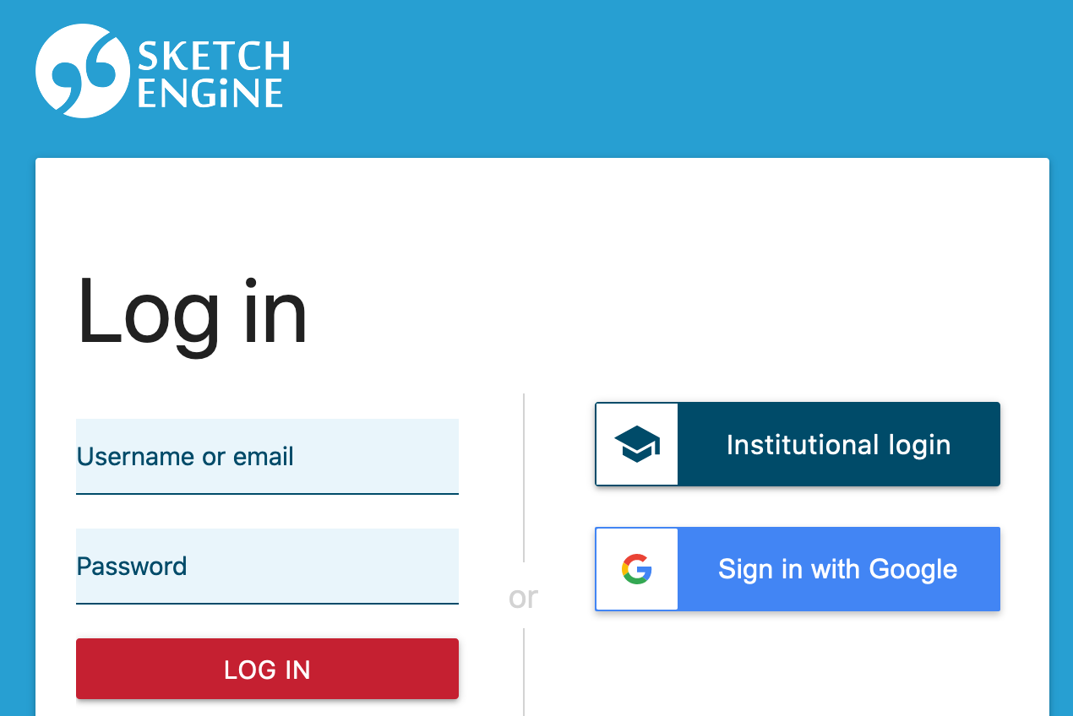
Sketch Engine
https://auth.sketchengine.eu/
large selection of corpora in many languages available
upload / create own corpora up to 1 M words
Free non-commercial access (until 03/2022)
select Institutional Login
enter home university account & password on SSO login page
agree to share your information
may need to create SkE account
User guide: https://www.sketchengine.eu/user-guide/

